Slide 1


Office Automation in Healthcare
Transforming Patient Care Through Intelligent Systems
Submitted by-: Angel Saini
UID-: 25BCA10066
Section-: 25BCA2-A

Slide 2
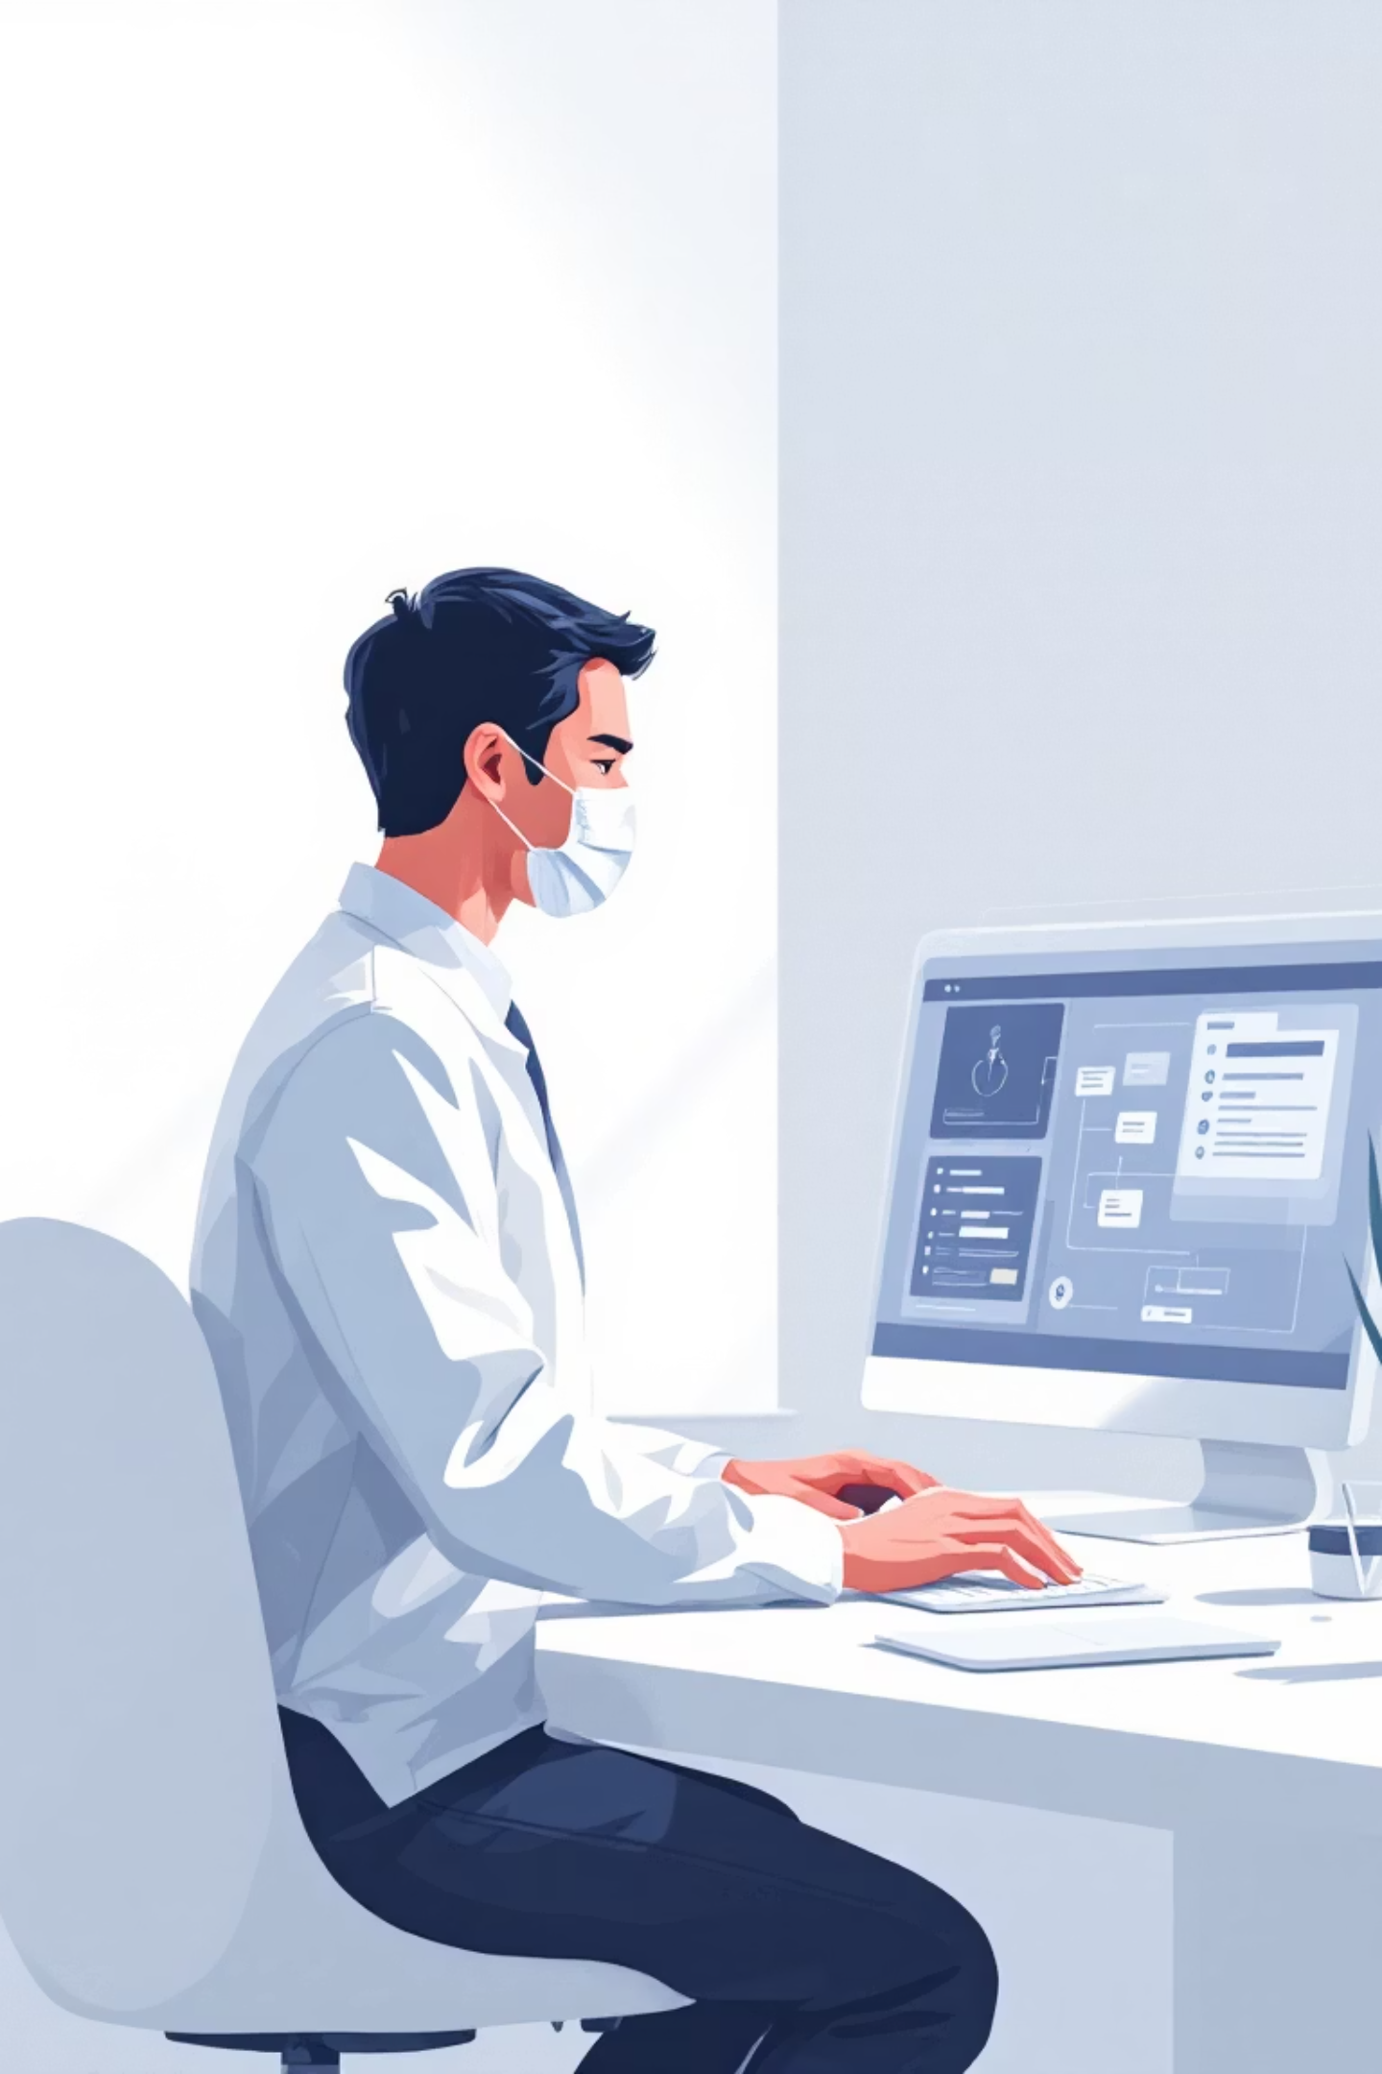
Executive Overview
The Challenge
The Solution
Healthcare delivery faces critical constraints: information fragmentation, manual processes, clinician burnout, and operational delays that compromise care quality and patient experience.
Office automation addresses these systematically through intelligent workflow orchestration, reducing errors, accelerating throughput, and enabling clinicians to focus on high-value care activities.

Slide 3



Three Pillars of Healthcare Automation
Safety & Accuracy
Efficiency & Throughput
Experience & Access
Eliminate human errors in scheduling, medication reconciliation, billing processes, and clinical documentation through systematic validation and cross-checking.
Reduce patient wait times, maximize productive clinical encounters, minimize administrative overhead, and optimize resource allocation across the care continuum.
Streamline patient interactions through self-scheduling, intelligent triage, automated reminders, and consistent follow-up communication protocols.

Slide 4

Automation Scope: From Front Office to Analytics
01
Patient-Facing Automation
Online appointment booking, automated reminders via SMS/email/voice, digital intake forms, and telehealth triage systems.
02
Back-Office Operations
Claims submission, denial management, inventory reordering, staff rostering, and supply chain coordination.
03
Clinical-Adjacent Support
Documentation augmentation via NLP, medication reconciliation, referral routing, and preauthorization workflows.
04
Data Orchestration
ETL pipelines, real-time dashboards, quality measures (HEDIS), and predictive analytics for no-shows and readmission risk.

Slide 5

Technical Architecture Foundation
Integration Standards
FHIR & HL7: Standardized clinical resource exchange and interoperability frameworks
RESTful APIs: Microservices exposing scheduling, patient lookup, and reminder capabilities
Event Streaming: Kafka-based message buses enabling decoupled, event-driven automation workflows
Core Components
BPM workflow engines (Camunda) for multi-step process orchestration
Business rule engines (Drools) for regulatory and payer logic
RPA for legacy system integration where APIs are unavailable

Slide 6




Intelligent Automation Technologies
Robotic Process Automation
NLP & Speech Recognition
Screen scraping and transaction automation for legacy systems lacking modern APIs—bridging the gap between old and new infrastructure.
Automated note drafting, clinical entity extraction (medications, diagnoses), intake form parsing, and intelligent coding recommendations.
Machine Learning Models
Conversational Agents
No-show risk prediction, patient stratification, demand forecasting for staffing, and anomaly detection in billing—all with explainability frameworks.
Chatbots collecting previsit information, triaging symptoms, answering FAQs, and intelligently escalating complex cases to human staff.

Slide 7




Critical Algorithms in Healthcare Automation
Scheduling Optimization
Demand Forecasting
Constraint satisfaction, integer programming, and reinforcement learning for dynamic overbooking policies and resource allocation.
Time-series methods (ARIMA, Prophet, LSTM) combined with stochastic optimization for capacity planning under uncertainty.
Clinical NLP
Clinical Decision Support
Transformer models for entity recognition, note sectioning, summarization, and vocabulary mapping to SNOMED CT and ICD codes.
Rule-based and ML-driven alerts for allergies, dosing checks, and care gaps—with explainability and clinician override capabilities.

Slide 8
Challenges and Strategic Mitigations
Data Quality & Integration
Clinician Workflow Fit
Risk: Fragmented records and inconsistent coding across systems.
Risk: Automation that interrupts workflows may be rejected by end users.
Mitigation: Robust ETL processes, canonical FHIR models, normalization services, and validation layers.
Mitigation: Human-in-the-loop design, configurable thresholds, iterative user testing, and training programs.
Privacy & Compliance
Model Drift & Safety
Risk: PHI exposure and regulatory violations (HIPAA, GDPR).
Risk: Biased predictions and degraded model performance over time.
Mitigation: Privacy-by-design principles, encryption, data minimization, comprehensive audit logging, and legal review.
Mitigation: Continuous monitoring, recalibration protocols, explainability frameworks (SHAP/LIME), and conservative fallback mechanisms.

Slide 9
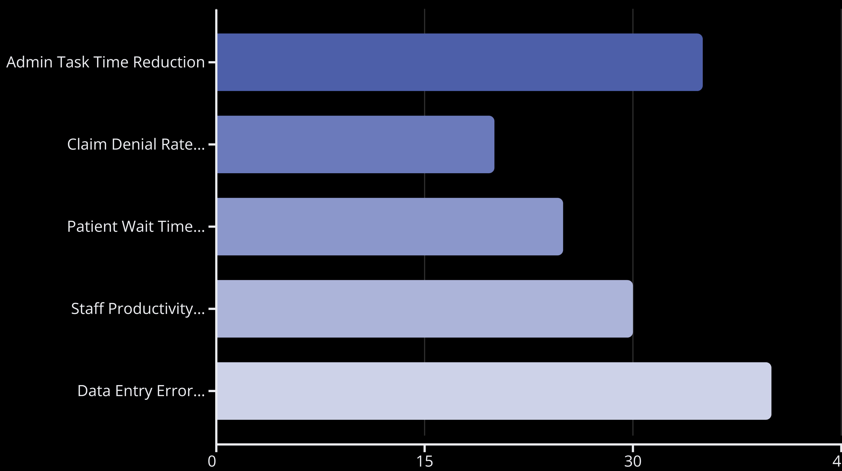
Quantifiable Impacts of Healthcare Automation
Implementing intelligent automation across healthcare operations yields significant, measurable improvements in efficiency, accuracy, and overall service delivery. The following chart highlights key areas where automation drives substantial positive change.
These figures demonstrate automation's potential to free up valuable staff time, enhance financial performance, and improve patient flow, ultimately contributing to a more effective and responsive healthcare system.

Slide 10

Path Forward: Implementing Intelligent Automation
1.Strategic Planning
Define key business processes suitable for automation.
Conduct a feasibility analysis to identify areas with the highest ROI.
2. Technology Selection
Choose the right tools (e.g., RPA platforms, AI/ML frameworks, workflow engines).
Ensure scalability, integration capability, and security compliance.
3. Challenges and Considerations
Change management: Employees must adapt to new workflows.
Data privacy and security: Sensitive data must be handled carefully.
Integration issues: Automation tools must align with legacy systems.
Continuous learning: AI models require updates to remain effective.
4. Benefits of Intelligent Automation
Increases efficiency and productivity.
Enhances accuracy and reduces human error.
Frees employees for higher-value, strategic tasks.
Provides real-time data insights for better decision-making.

Slide 11
Case Study – Apollo Hospitals
Overview:
Apollo Hospitals implemented office automation to enhance patient care, speed, and data accuracy.
Challenges:
Manual booking, billing delays, and scattered patient data slowed operations.
Solutions:
Online appointment & billing system
Electronic Medical Records (EMR)
Automated reminders & claims
AI-based analytics for management
Results:
40% reduction in wait time
30% faster billing
Improved accuracy & patient satisfaction

Slide 12
CONCLUSION
Office automation in healthcare plays a vital role in improving efficiency, accuracy, and overall service quality. By automating routine administrative and clinical tasks such as scheduling, billing, and documentation, healthcare institutions can save time and reduce human errors. The use of advanced technologies like RPA, AI, and NLP ensures faster data processing and better coordination between departments.
This system not only enhances patient satisfaction through timely communication and reduced waiting time but also allows doctors and staff to focus more on patient care instead of paperwork. Overall, office automation leads to a smarter, more reliable, and patient-centered healthcare environment that supports better decision-making and smooth day-to-day operations.

Slide 13

THANK YOU
THANK YOU
Submitted by- Angel Saini
UID- 25BCA10066
Class- 25BCA2-A

